Slide 1

User Experience and User Interface Design
8 - Android UI Design Introduction - Multiscreen Apps
Dr. Seyed Reza Shahamiri More Info

Slide 2

Learn Māori App
2
In this lessen we will discuss the steps to design a multi screen app that helps learning Māori Language.
Create a new android project and name it “Learn Maori”, select min SDK API 21, “Empty Activity”, and leave the activity name as default.

Slide 3
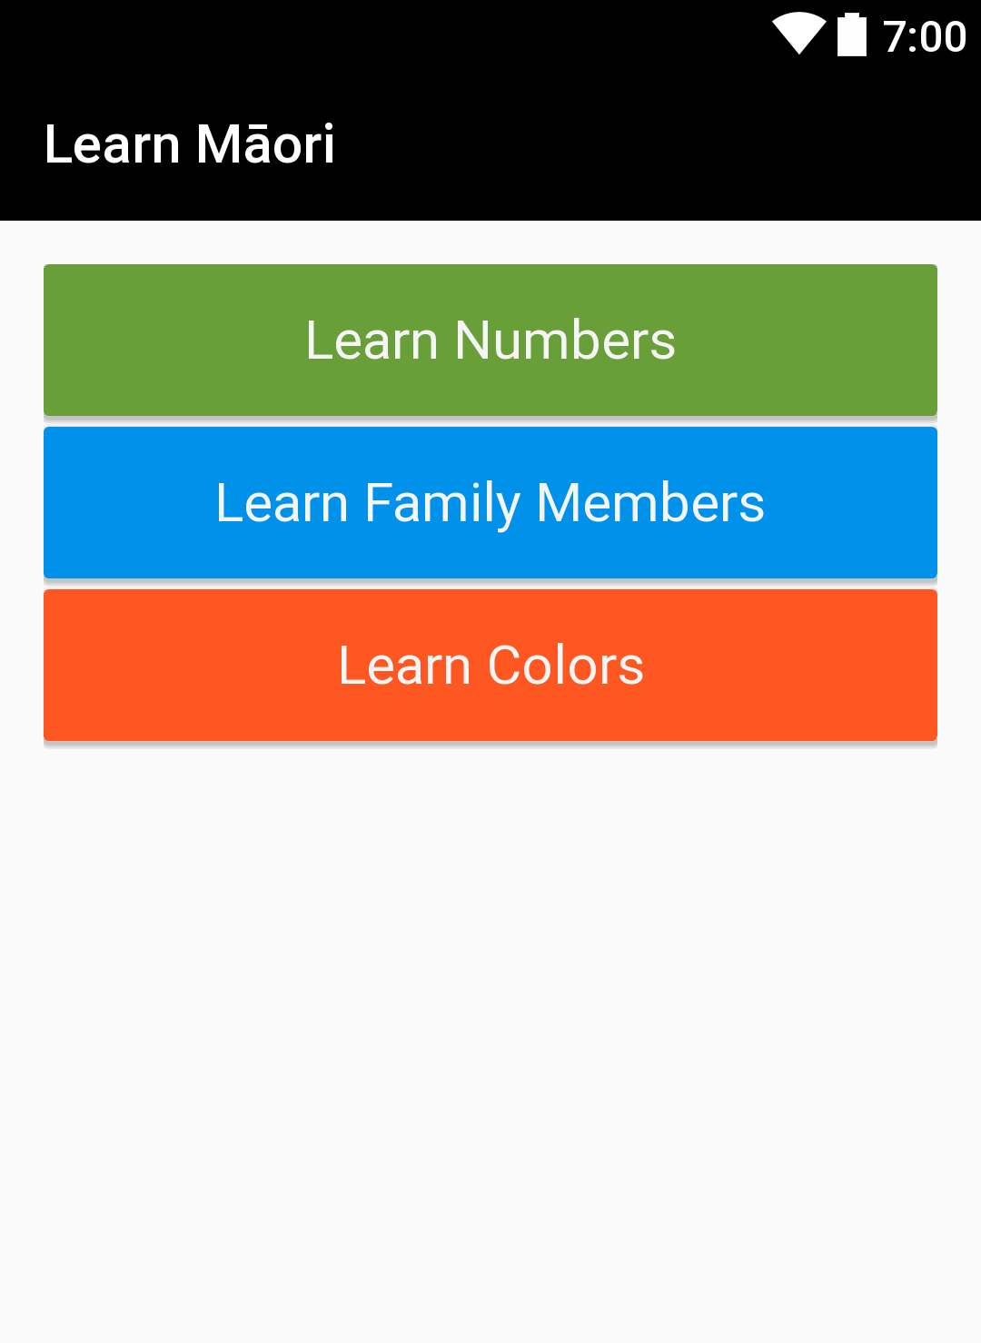
Learn Māori App MainActivy
3
The first activity is to select what category of words to view:
CardView
TextView

Slide 4
Learn Māori App MainActivy Styles
4
Before designing the layout, create the styles for CardViews and TextViews. You can also select your own colors.
First, create the CardView style:
<style name="CategoryCardStyle" > <item name="android:layout_height">wrap_content</item> <item name="android:layout_width">match_parent</item> <item name="android:layout_marginBottom">4dp</item> <item name="cardElevation">8dp</item> </style>

Slide 5
Learn Māori App MainActivy Styles
5
Next, create the TextView style:
<style name="CategoryTextStyle"> <item name="android:textSize">20sp</item> <item name="android:layout_width">match_parent</item> <item name="android:layout_height">match_parent</item> <item name="android:gravity">center_vertical|center_horizontal</item> <item name="android:layout_margin">16dp</item> <item name="android:textColor">#F5F5F5</item> </style>

Slide 6
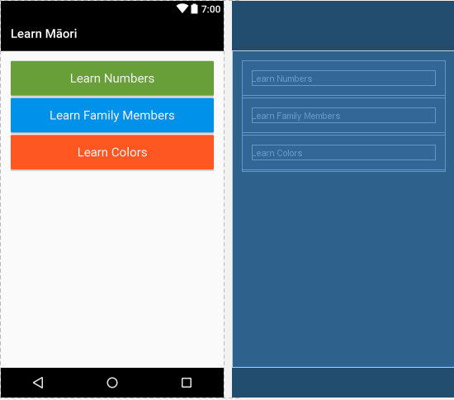
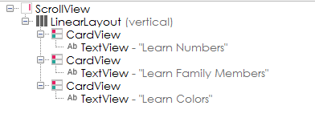
Learn Māori App MainActivy
6
Design the main activity:

Slide 7
Learn Māori App MultiScreen
7
Pressing any of the CardViews should open the related activity.
In order to do so, you need to add new activities to your app, and program your app to show them when required.

Slide 8
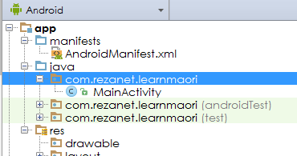
Learn Māori App MultiScreen Add New Activity
8
To add new activities, right click on the app module name inside “java” as shown below:

Slide 9
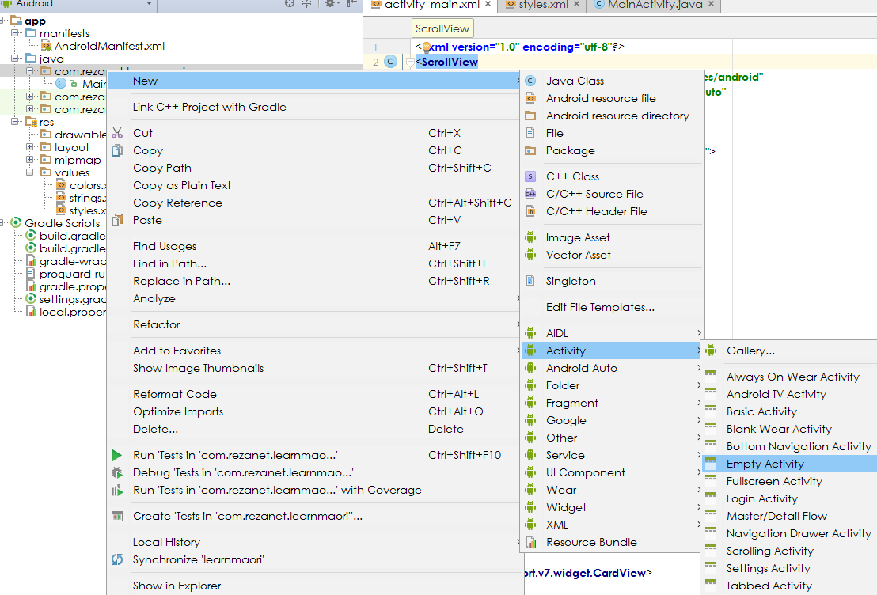
Learn Māori App MultiScreen Add New Activity
9
Then, select New, Activity, and the activity template that you need.

Slide 10
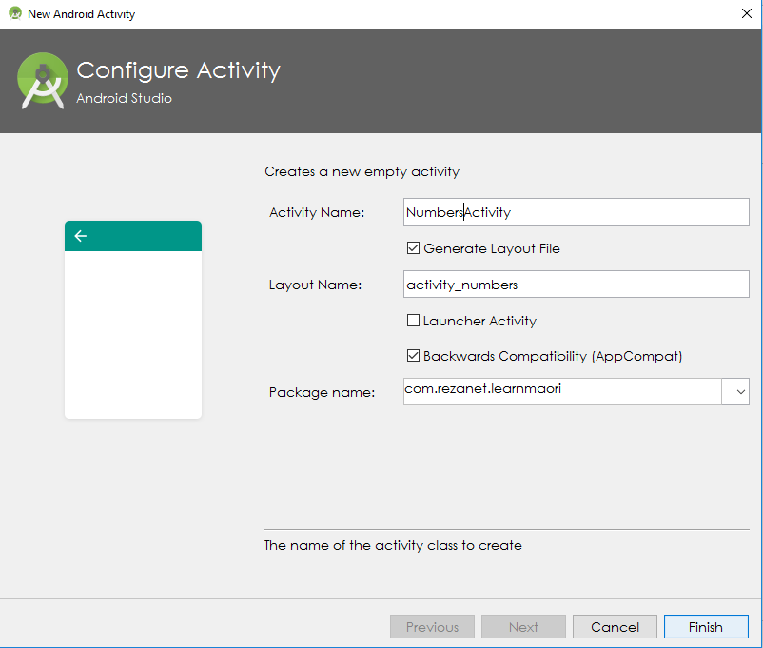
Learn Māori App MultiScreen Add New Activity
10
Next, select a name for your activity and press Finish.
Name your activity NumbersActivity.
Change “rezanet” with your name

Slide 11
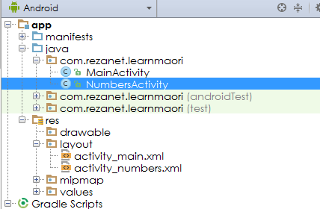
Learn Māori App MultiScreen Add New Activity
11
Android Studio creates both the java activity and layout files:

Slide 12
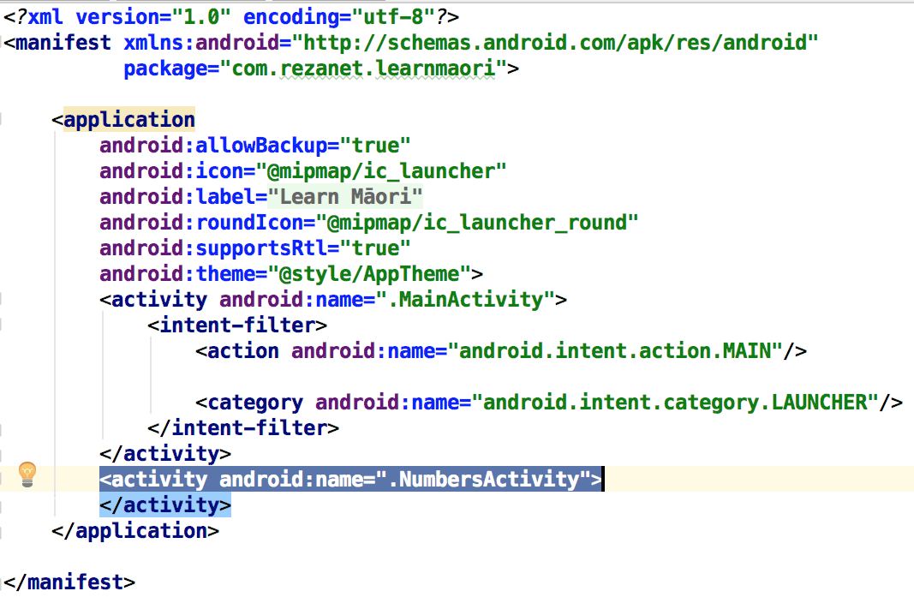
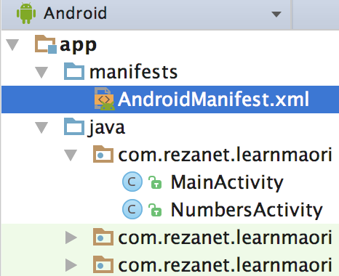
Learn Māori App MultiScreen Add New Activity
12
Adding new activities also add new entries in AndroidManifest.xml. It acts like a table of contents for the app.
Activity Attributes in AndroidManifesto

Slide 13
Learn Māori App MainActivity onClick handler
13
The next step is to program the MainActivty to start and show NumbersActivity when “Learn Numbers” is touched.
This can be done by capturing the onClick event handler of each CardView similar to buttons. For example:
Then, add the ShowNumbersActivity to MainActivity.java:
<android.support.v7.widget.CardView style="@style/CategoryCardStyle" app:cardBackgroundColor="#689F38" android:onClick="ShowNumbersActivity" >
public void ShowNumbersActivity(View view){ //Show NumbersActivity }

Slide 14
Learn Māori App MainActivity onClick handler
14
Then, ShowNumbersActivity event handler need to be programmed to show NumbersActivity. This is done by sending an intent to open NumbersActivity:
public void ShowNumbersActivity(View view){ //Show NumbersActivity Intent numbersActivity = new Intent (this, NumbersActivity.class); startActivity (numbersActivity); }
this refers to the current activity. It is the current context.

Slide 15
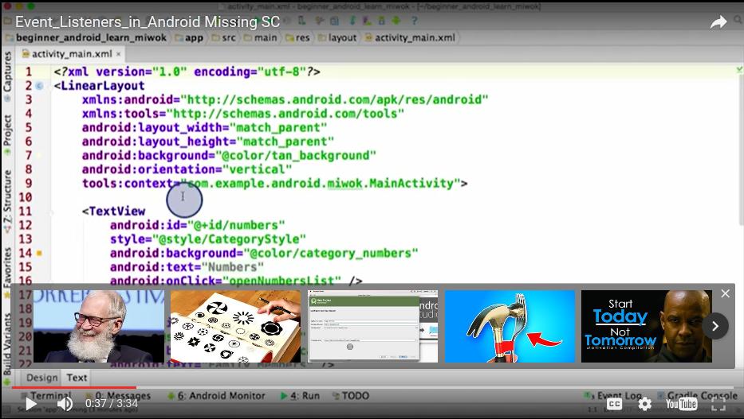
Learn Māori App MainActivity onClick Listener
15

Slide 16
Learn Māori App MainActivity onClick Listener
16
onClick Listeners are particularly important if the views are generated dynamically.
Also, if you want to change the behaviour of onClick during app execution.
Let’s update the Numbers card to use onClick Listener instead on setting andoird:onCLick by removing
android:onClick="ShowNumbersActivity"

Slide 17
Learn Māori App MainActivity onClick Listener
17
In order to add onClick Listener:
1. Ensure the view has an id:
2. In java activity class onCreate() create an object of the CardView and set its onClick Listener:
<android.support.v7.widget.CardView style="@style/CategoryCardStyle" app:cardBackgroundColor="#689F38" android:id="@+id/card_numbers" >
CardView cardNumbers = (CardView) findViewById(R.id.card_numbers); cardNumbers.setOnClickListener(CardNumbersHandler);

Slide 18
Learn Māori App MainActivity onClick Listener
18
In order to add onClick Listener:
3. Declare the handler inside the activity class (not inside another methods):
View.OnClickListener CardNumbersHandler = new View.OnClickListener() { public void onClick(View view) { //Operations to perform when the view is clicked //For example showing NumbersActivity Intent numbersActivity=new Intent(getBaseContext(),NumbersActivity.class; startActivity(numbersActivity); } };
Since the method is not inside one of the default activity class methods, we cannot use this. Instead, we use getBaseContext() that returns the base context of the activity.

Slide 19
Learn Māori App MainActivity Sending data from other activities
19
When starting new activities, you can send some data as well while creating the activity intent:
Intent numbersActivity=new Intent(getBaseContext(),NumbersActivity.class). putExtra(Intent.EXTRA_TEXT,"This message was sent from MainActivity!"); startActivity(numbersActivity);

Slide 20
Learn Māori App MainActivity Receiving data from other activities
20
In the other activity you can receive the data. In order to do so, update onCreate event handler inside the receiving activity (NumbersActivity in this example):
@Override protected void onCreate(Bundle savedInstanceState) { super.onCreate(savedInstanceState); setContentView(R.layout.activity_numbers); Intent intent=getIntent(); String dataFromAnotherActivity=intent.getStringExtra(Intent.EXTRA_TEXT); // Consume dataFromAnotherActivity }

Slide 21
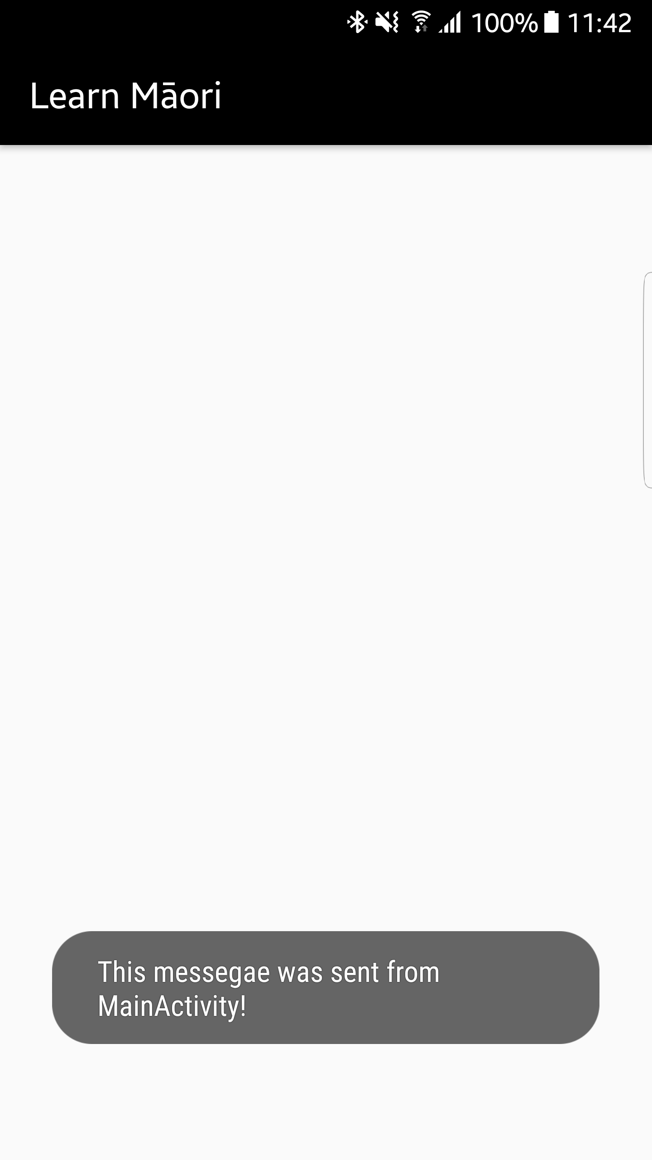
Learn Māori App MainActivity Receiving data from other activities
21
For example, you can show it as a toast:
Intent intent=getIntent(); String dataFromAnotherActivity=intent.getStringExtra(Intent.EXTRA_TEXT);
// Consume dataFromAnotherActivity
Toast.makeText(getBaseContext(), dataFromAnotherActivity, Toast.LENGTH_LONG).show();

Slide 22
Learn Māori App MainActivity Updating activity title
22
You can update the title of an activity by setting label attribute of the activty in AndroidManifest.xml:
<activity android:name=".NumbersActivity" android:label="Numbers"> </activity>

Slide 23
Learn Māori App NumbersActivity Changing Activity Theme
23
You can have separate themes for different activities:
Create a new theme in styles.xml:
Update AndroidManifesto.xml activity’s entry:
<style name="NumberActivityTheme" parent="AppTheme"> <item name="colorPrimary">#689F38</item> <item name="colorPrimaryDark">#689F38</item> </style>
<activity android:name=".NumbersActivity" android:label="Numbers" android:theme="@style/NumberActivityTheme"> </activity>

Slide 24
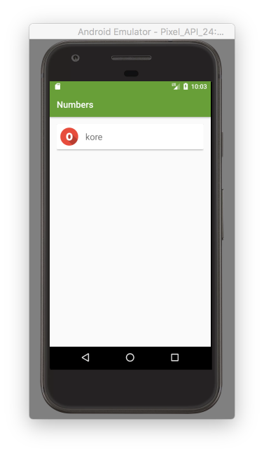
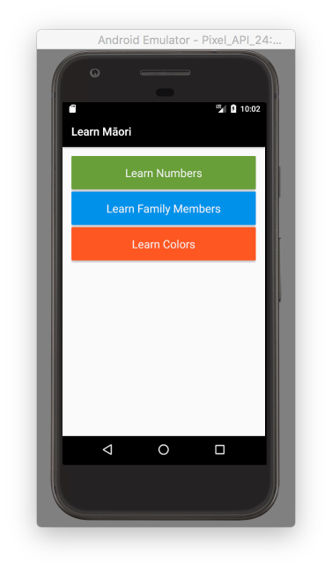
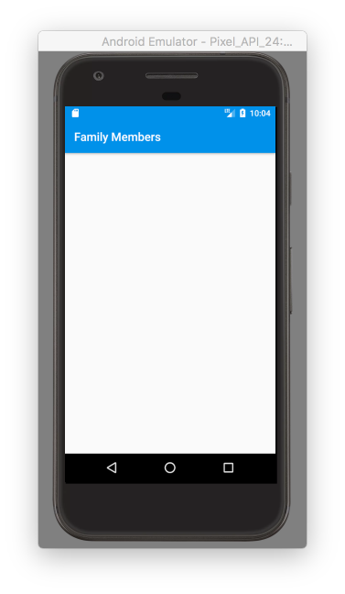
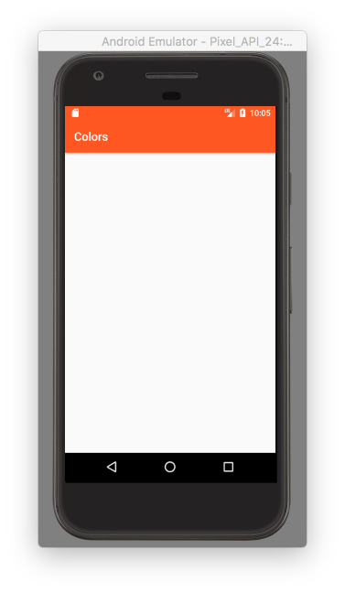
Learn Māori App
24
Add the remaining activities of your choice, set their titles and new theme, and code MainActivity to show them.

